Slide 1
Drone Racing Optimal Control and Trajectory Estimation
Antoni Rosinol

Slide 2

Motivation

Slide 3
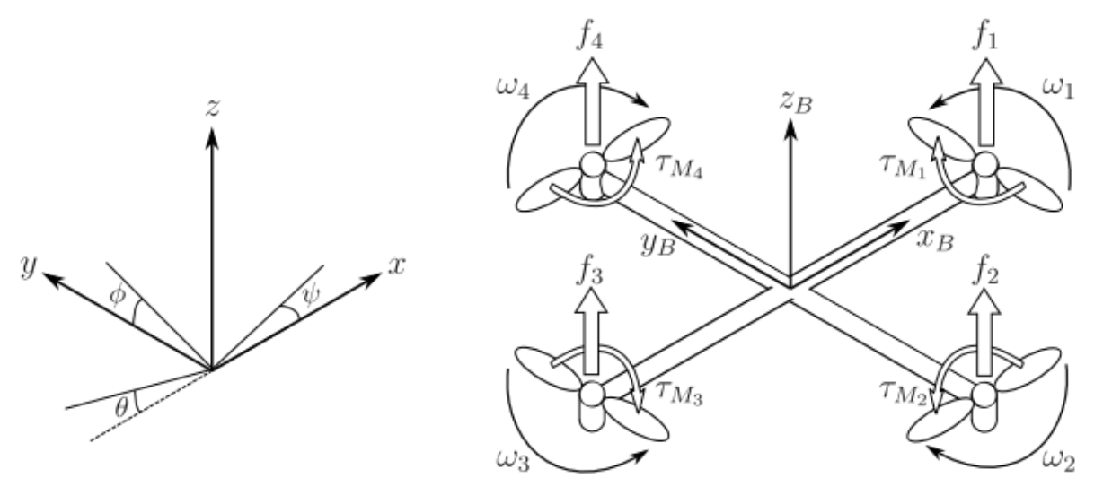
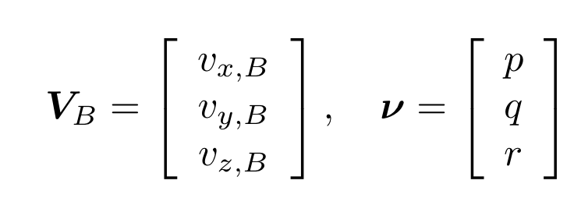
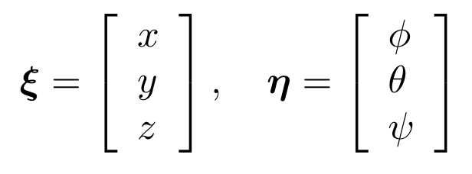
Drone Dynamics
Absolute Position
Absolute Orientation
Linear Velocities
Angular Rates

Slide 4
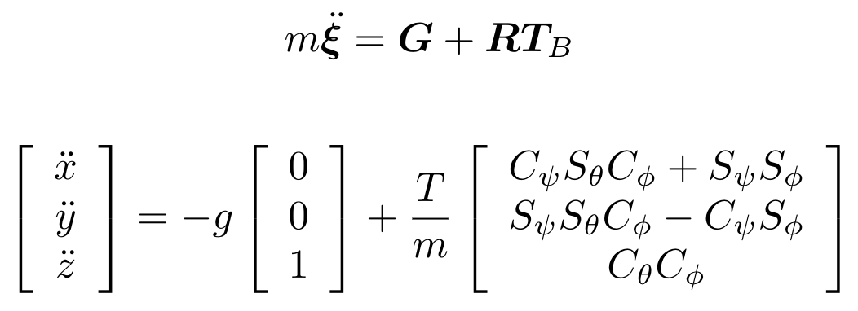
Drone Dynamics
Newton’s Second Law:

Slide 5
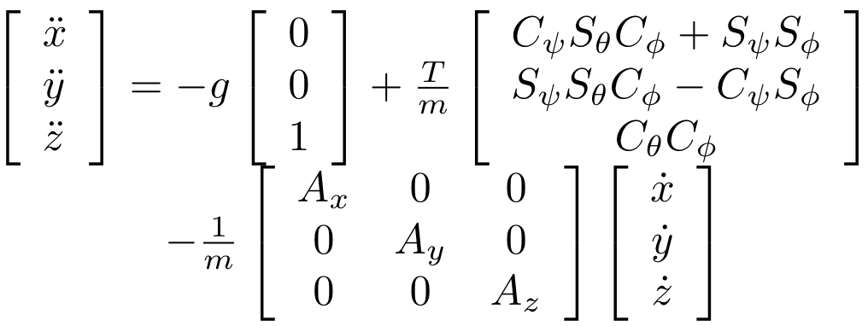
Drone Dynamics
Considering Aerodynamic Drag:

Slide 6
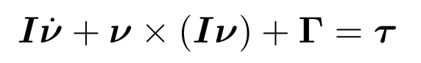
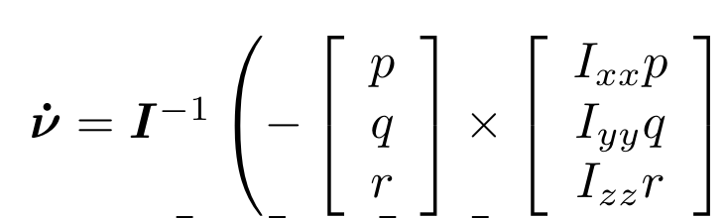
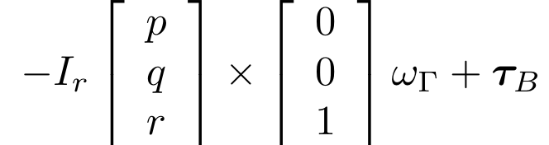
Drone Dynamics
Euler’s Second Law:

Slide 7
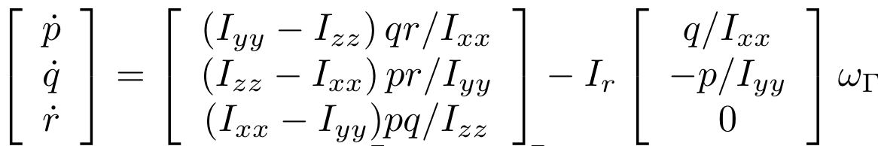
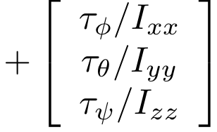
Drone Dynamics
Euler’s Second Law:

Slide 8
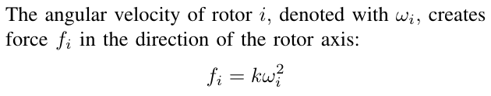
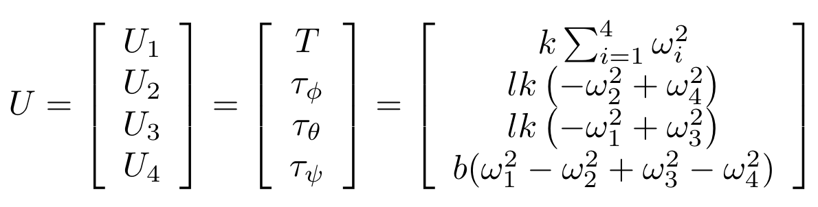
Control Inputs

Slide 9
Drone Dynamics
State:
Control:

Slide 10
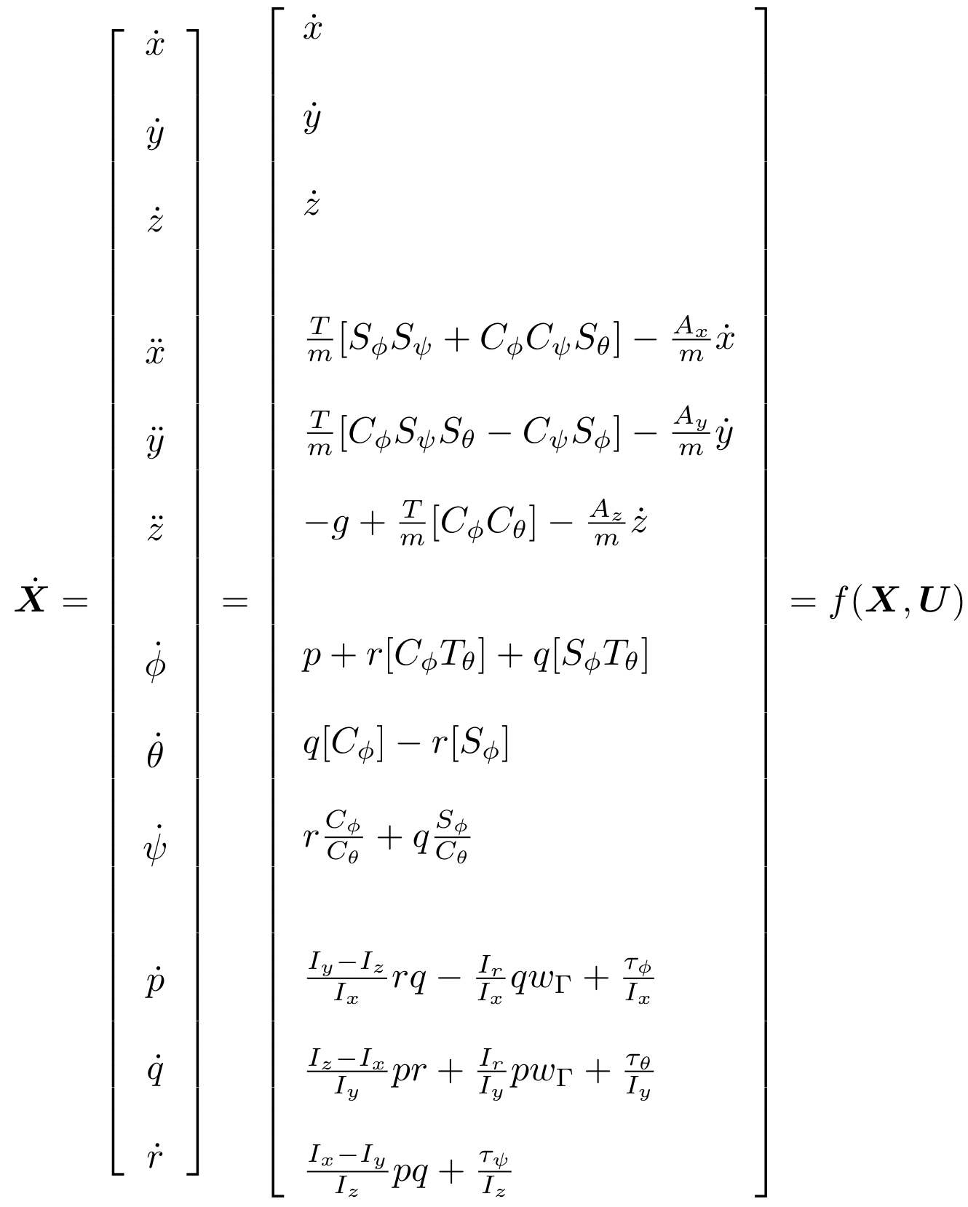
State-Space Dynamics

Slide 11
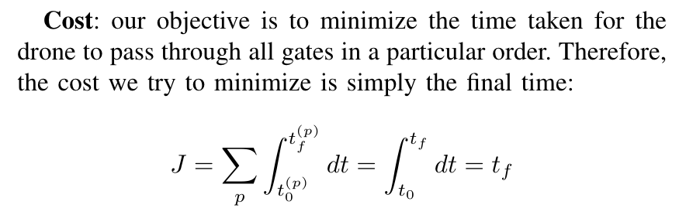
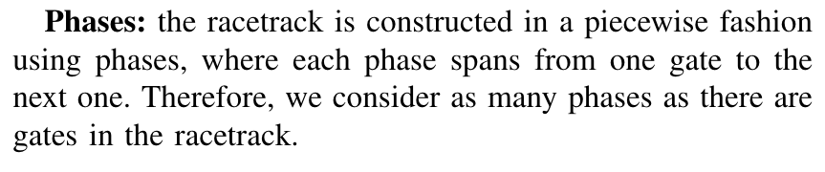
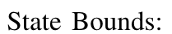
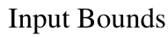
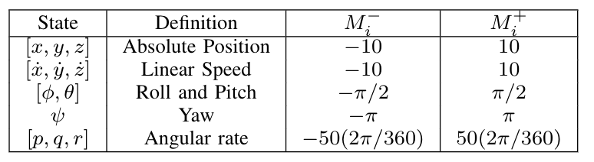
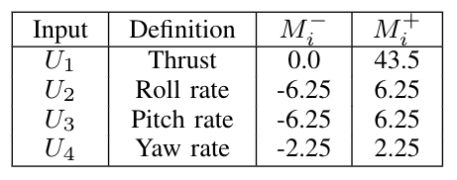
Minimum Time Optimal Control Problem

Slide 12
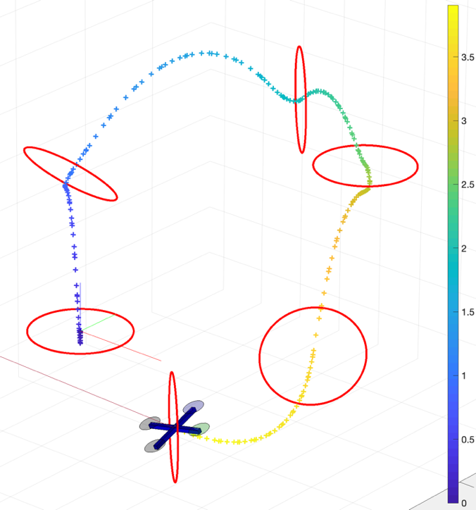
Drone Racing

Slide 13
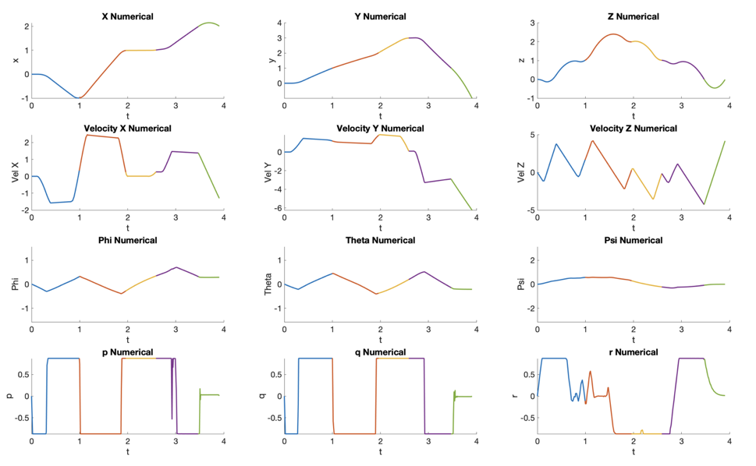
Optimal State (trajectory)

Slide 14
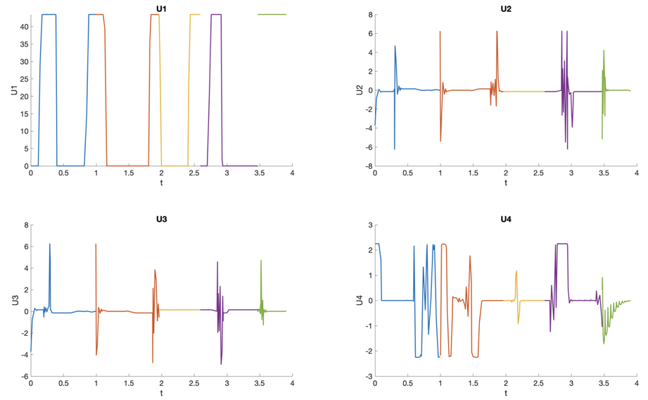
Optimal Controls
Roll Rate
Thrust
Pitch Rate
Yaw Rate

Slide 15
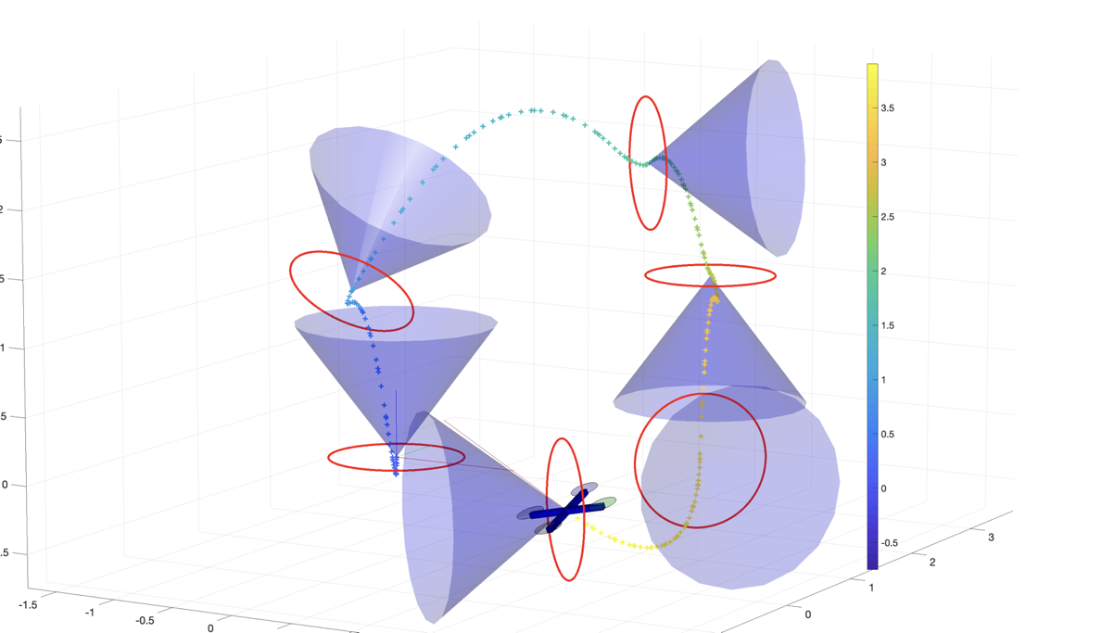
Conic Constraints for Gate Traversal

Slide 16
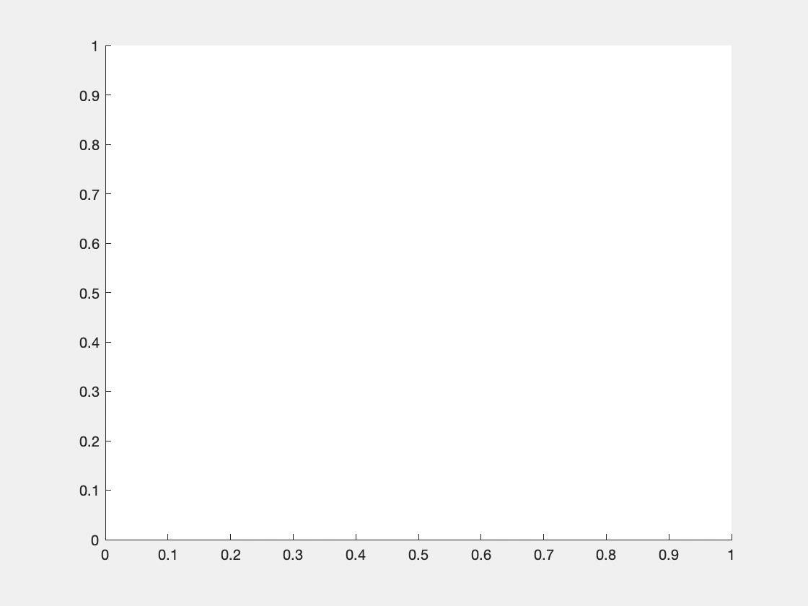
Conic Constraints for Gate Traversal

Slide 17
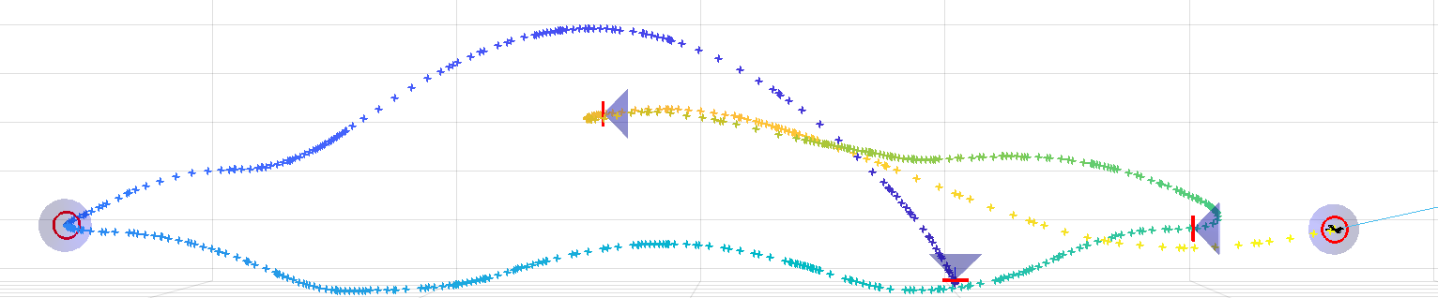

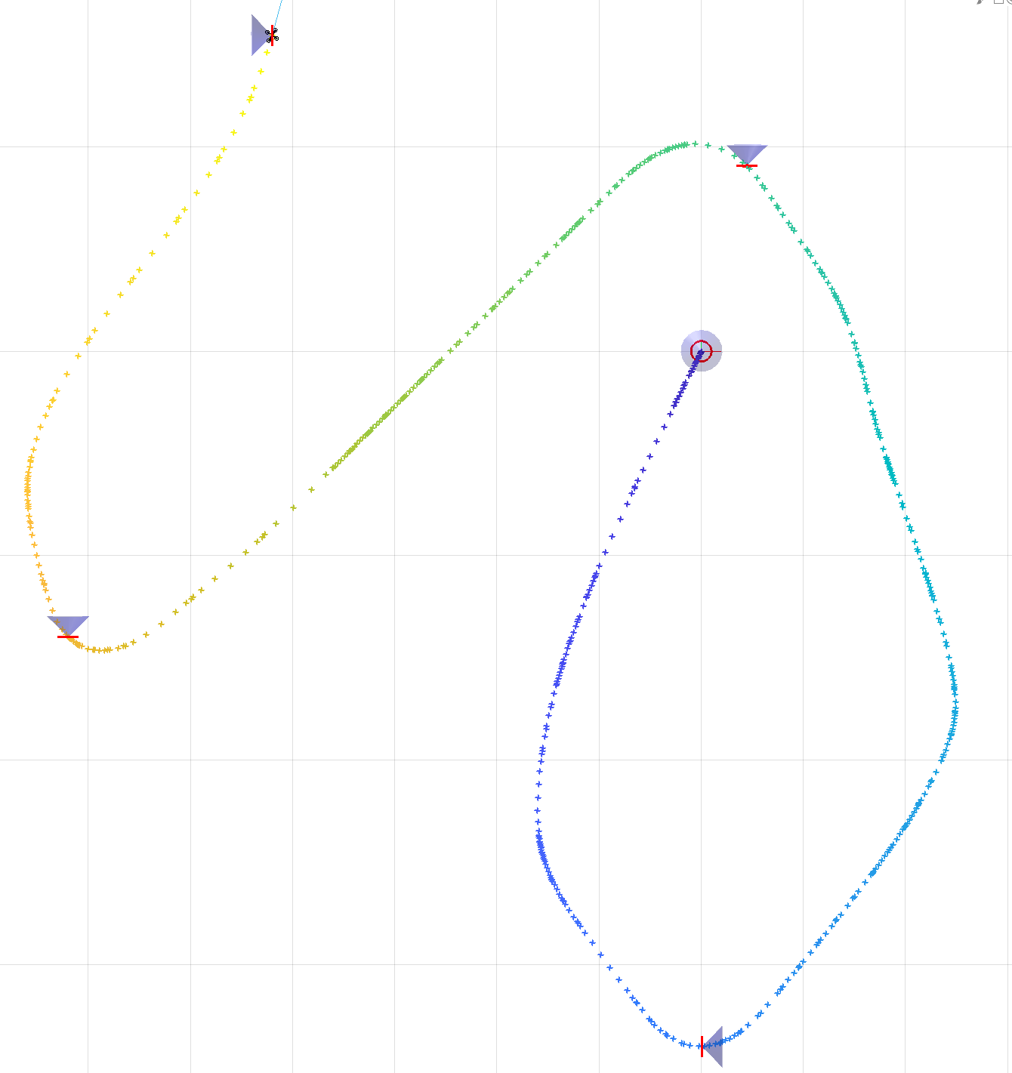
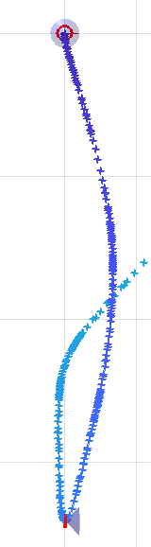
Drone Race
Y-Z View
… wo conic constraints
X-Y View

Slide 18
Drone Race
The real race…
Give me a second while I look for it, thanks!

Slide 19
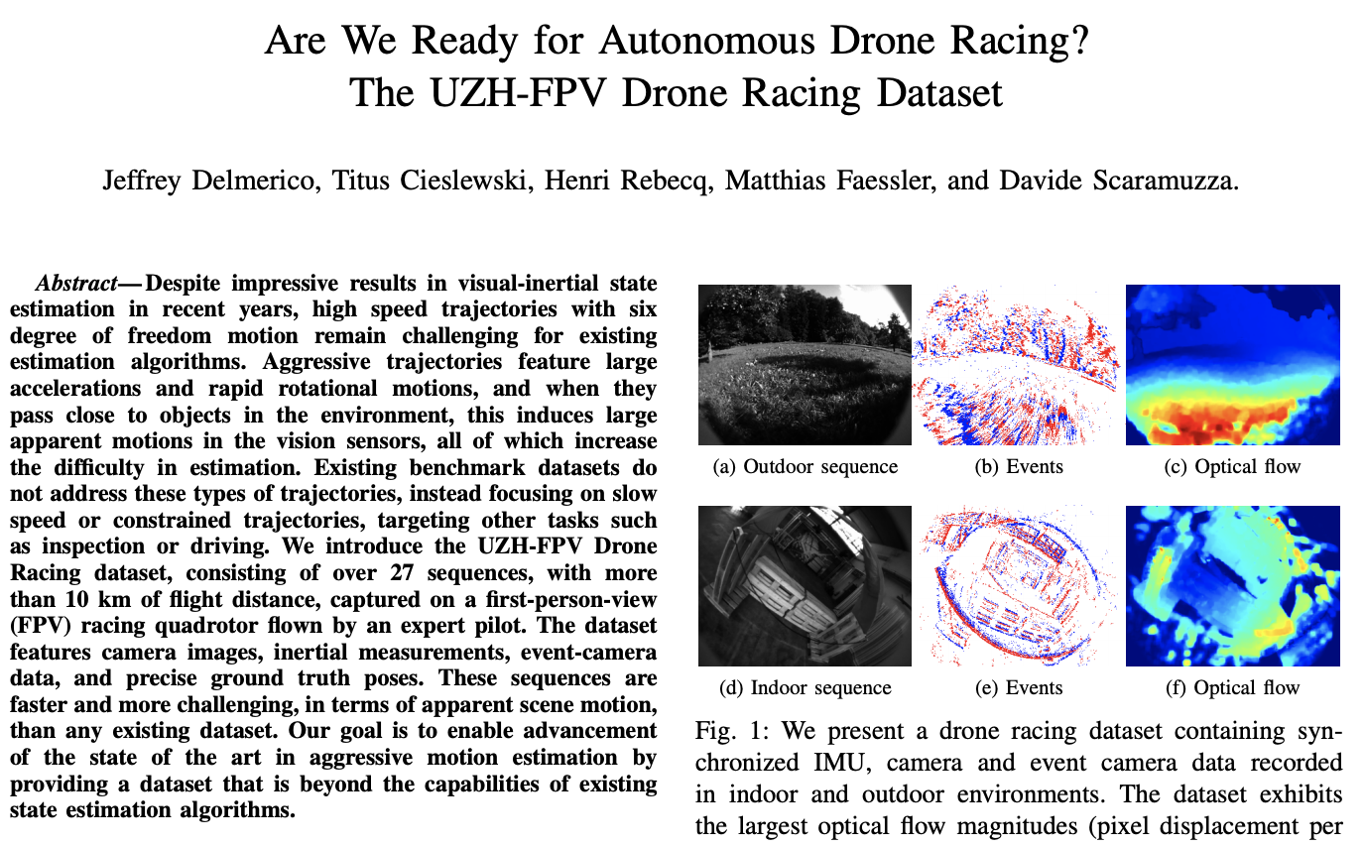
Conclusion

Slide 20
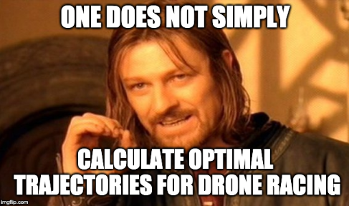
Conclusion

